Slide 1
Computer Vision

Slide 2
What Can CNNs Do?
Image Classification
Object Detection
Neural Style Transfer
Face Recognition
Image Synthesis

Slide 3
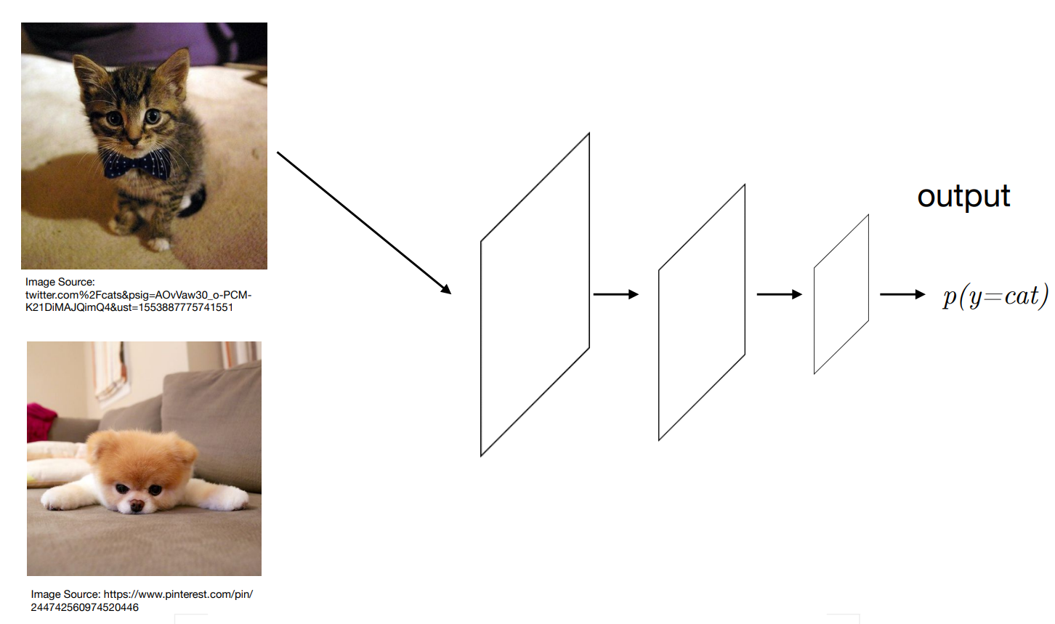
Image Classification

Slide 4
Why CNNs?

Slide 5
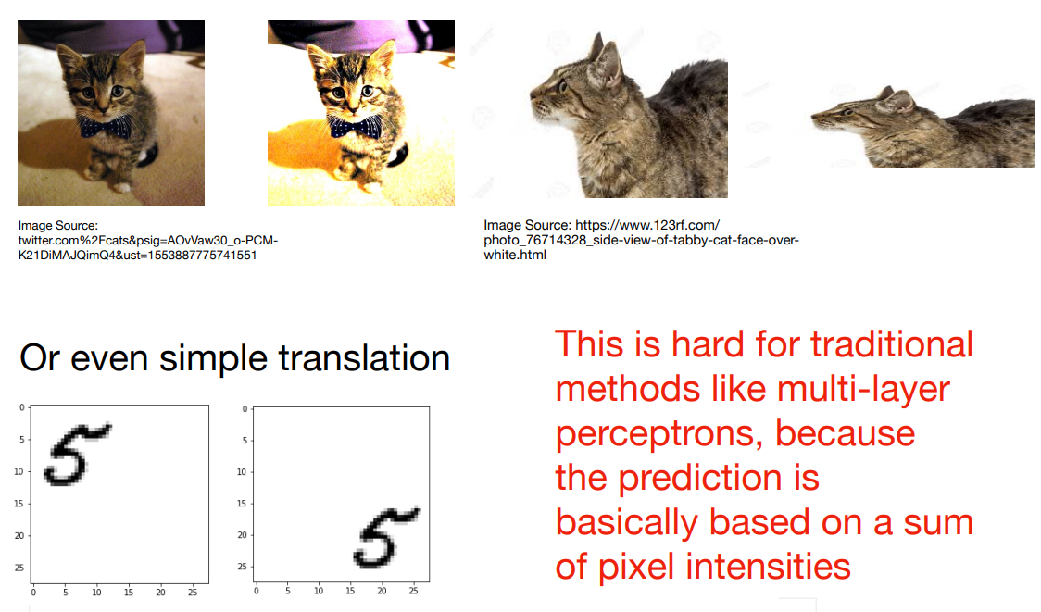
Different lighting, contrast, viewpoints

Slide 6
Number of Parameters
1000x1000 pixel image with three channels then we would have 3 million input features.
If the first layer has 1000 neurons the neural net with just one layer would have approximately 3 billion parameters.

Slide 7
CNN Basics

Slide 8
CNN Principles
Translation invariance - Our network should respond similarly to the same patch, regardless of where it appears in the image.
Locality principle - Our network should focus on local regions, without regard for the contents of the image in distant regions.

Slide 9
WbWhat Is a CNN?
The convolutional neural network (CNN) is a specialized feedforward neural network designed to process multi-dimensional data, e.g., images
A CNN is a special case of neural networks which uses convolution instead of full matrix multiplication in the hidden layers
A CNN architecture is typically comprised of convolutional layers, pooling (subsampling) layers, and fully-connected layers (LeNet-5)

Slide 10
What is a Convolution?
In each convolutional layer of a CNN, a convolutional operation is performed along with the input of predefined width and strides. Each of these convolutional operations is called a "kernel" or a "filter"
An activation function is applied after each convolution to produce the output

Slide 11
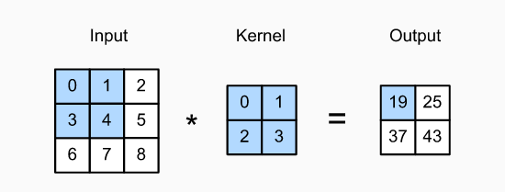
Convolution Operation
A single unit of a convolutional layer is only connected to a small receptive field of its input, where the weights of its connections define a filter
The convolution operation is used to slide the filter across the input, producing activations at each receptive field

Slide 12
Convolution Operation
The shaded portions are the first output element and the input and kernel array elements used in its computation:
0×0+1×1+3×2+4×3=19

Slide 13
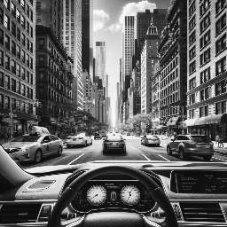

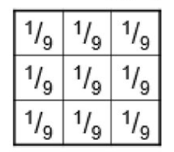
2D Discrete Convolution - uniform filter

Slide 14
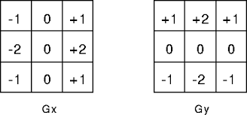
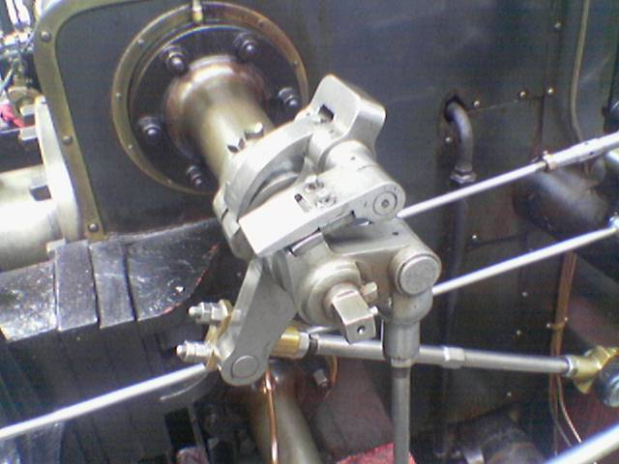
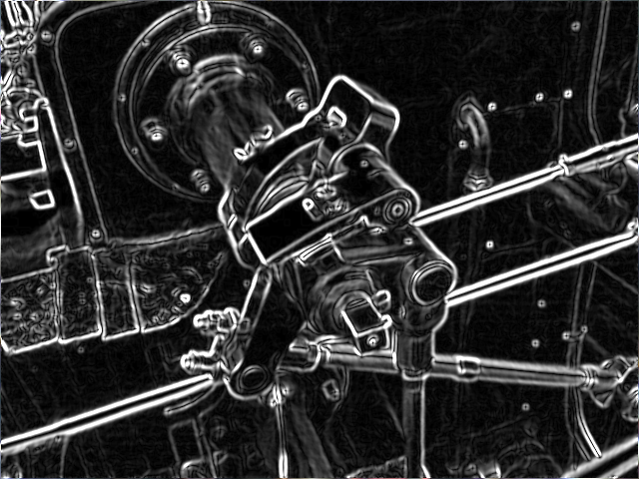
2D Discrete Convolution - Sobel operator
https://en.wikipedia.org/wiki/Sobel_operator

Slide 15
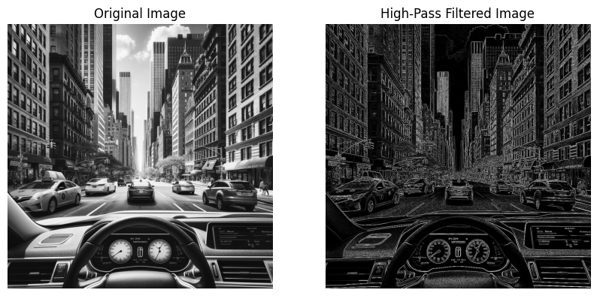
Low pass vs High pass filters
Low pass filters - allow low frequencies to pass through
Results in blurring and smoothing of the image
Useful in reducing noise and removing fine details
High pass filters - block low frequencies and allow high frequencies to pass through
Useful for detecting edges in an image, sharpening or enhancing details

Slide 16
Parameters Defining Convolution
Convolutions are defined by two key parameters:
Size of the filters extracted from the inputs. These are typically 3×3 (most frequently used), or 5×5
Depth of the output feature map - The number of filters computed by the convolution

Slide 17
Main Concepts Behind Convolutional Neural Networks
Sparse-connectivity: A single element in the feature map is connected to only a small patch of pixels. (This is very different from connecting to the whole input image, in the case of multilayer perceptrons.)
Parameter-sharing: The same weights are used for different patches of the input image.
Many layers: Combining extracted local patterns to global patterns

Slide 18
Weight Sharing
A "feature detector" (filter, kernel) slides over the inputs to generate a feature map
Rationale: A feature detector that works well in one region may also work well in another region
A big reduction in parameters to fit
Multiple "feature detectors" (kernels) are used to create multiple feature maps

Slide 19
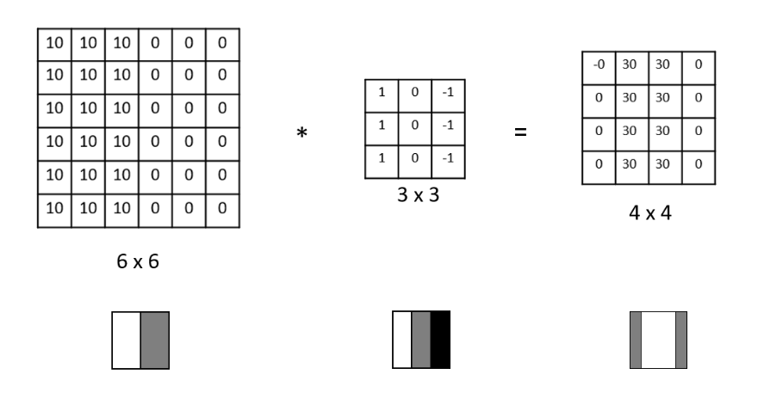
Edge Detection Example

Slide 20
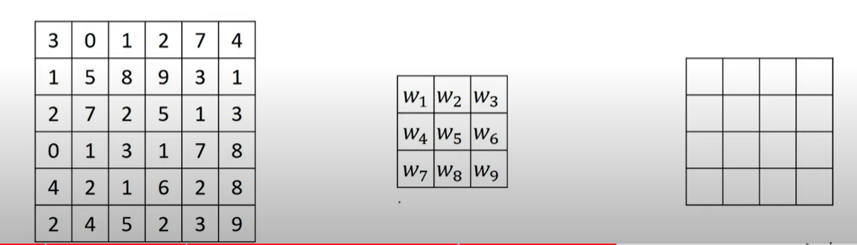
How Do We Choose the Weights of the Filters?
We use Gradient Descent and Backpropagation to find the optimal weights of the different filters.

Slide 21
Padding
Padding can increase the height and width of the output.
Padding works by adding an appropriate number of rows and columns on each side of the input feature map
This is often used to give the output the same height and width as the input to avoid undesirable shrinkage of the output
Padding ensures that all pixels are used equally frequently.
Typically we pick symmetric padding on both sides of the input height and width.

Slide 22
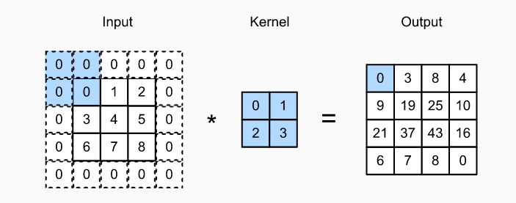
Padding

Slide 23
Padding in Pytorch
Some padding terminologies:
“constant” padding: pads the input tensor with a constant value
“reflect” padding: pads the input tensor using the reflection of the input boundary
“circular” padding: pads the input tensor using the reflection of the input boundary
“replicate” padding: uses the replication of the input boundary

Slide 24
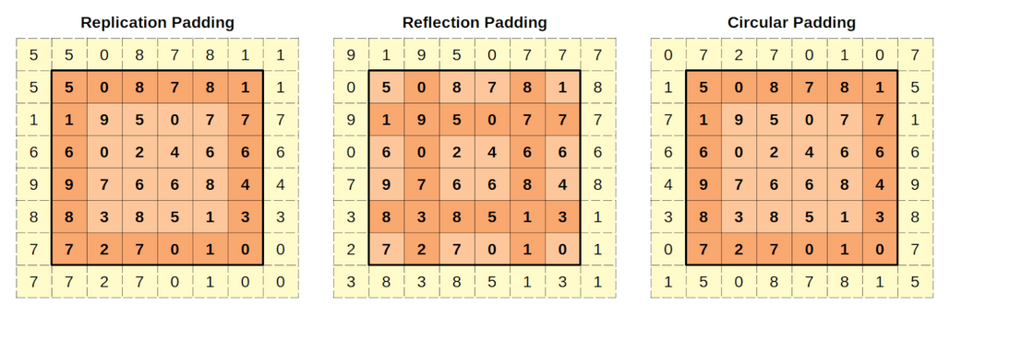
Padding in Pytorch

Slide 25
Stride
The distance between two successive windows is a parameter of the convolution, called its stride, which defaults to 1
It is possible to have strided convolutions: convolutions with a stride higher than 1.

Slide 26
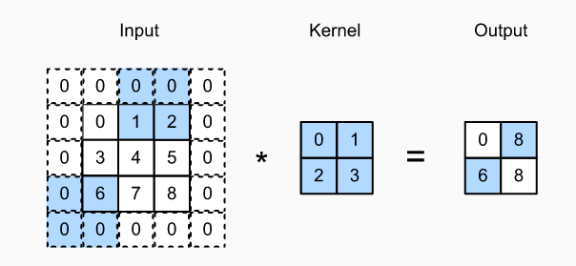
Stride of 2 Example

Slide 27
Pooling
Pooling is an exceedingly simple operation. It does exactly what its name indicates, aggregate results over a window of values
A big difference from convolution is that max-pooling is usually done with 2×2 windows and stride 2, to downsample the feature maps by a factor of 2
Pooling does not have any learnable parameters

Slide 28
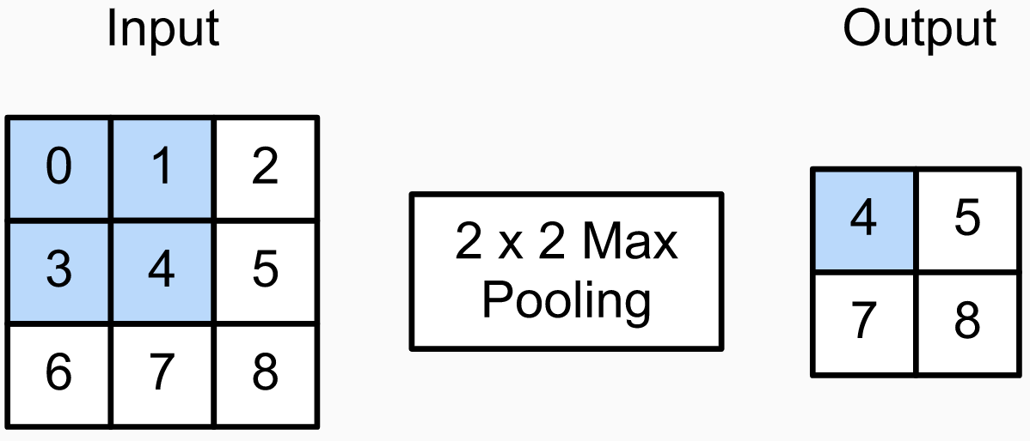
Pooling

Slide 29
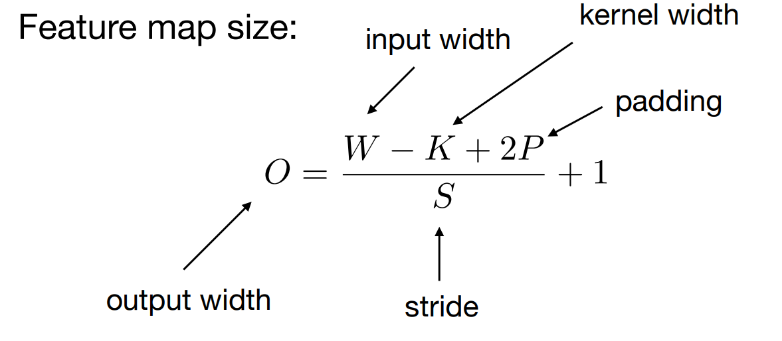
Size Before and After Convolutions

Slide 30
Convolutions with Color Channels

Slide 31
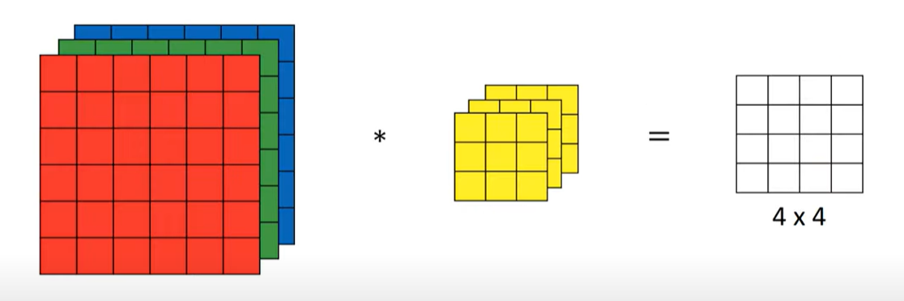
Convolutions with Color Channels
Convolving 6X6X3 with 3X3X3 gives you a 4X4 2D output

Slide 32
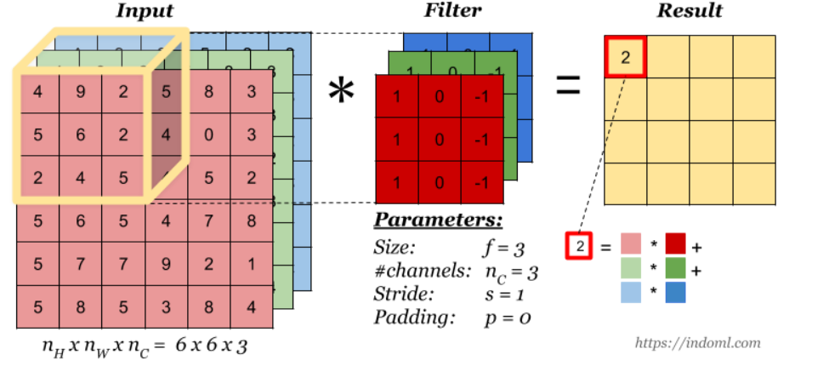
Convolutions with Color Channels

Slide 33
Convolution Operation with Multiple Filters
Multiple filters can be used in a convolution layer to detect multiple features.
The output of the layer then will have the same number of channels as the number of filters in the layer.

Slide 34
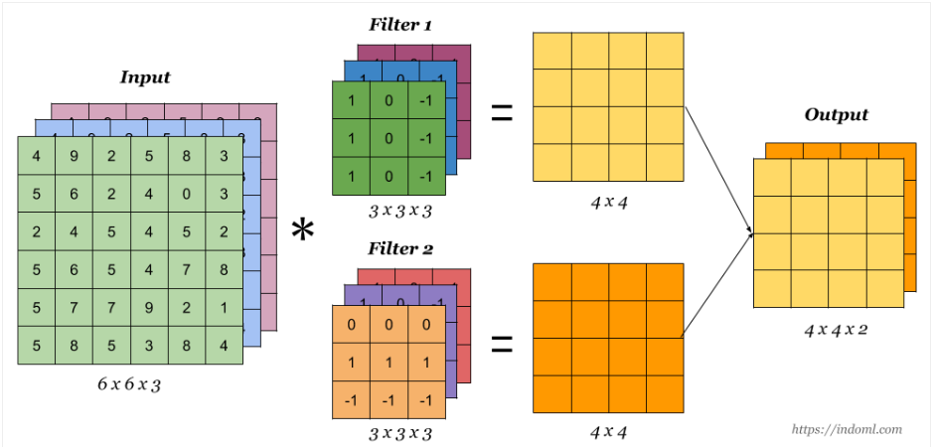
Convolution Operation with Multiple Filters

Slide 35
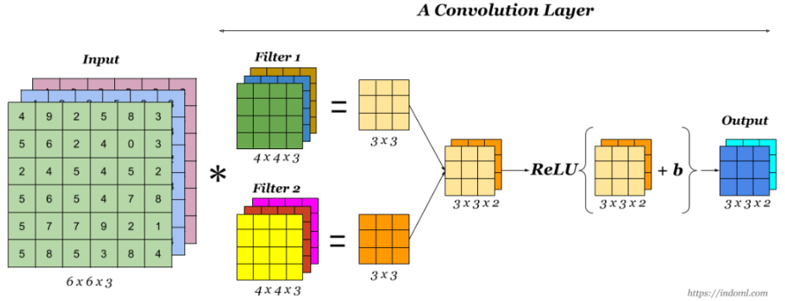
One Convolution Layer
Finally to make up a convolution layer, a bias is added and an activation function such as ReLU or tanh is applied.

Slide 36
One Convolution Layer Number of Parameters
If you have 10 filters 3x3x3 how many parameters do you have in this layer?
Does the number of parameters depend on the input size?

Slide 37
One Convolution Layer Number of Parameters
If you have 10 filters 3x3x3 how many parameters do you have in this layer?
Weights = 3*3*3 = 27
Bias = 1
Total parameters per filter = 28
Total Params for 10 Filters = 10 * 28 = 280 params

Slide 38
Data Augmentation

Slide 39
Data Augmentation
Image augmentation generates random images based on existing training data to improve the generalization ability of models.
In order to obtain definitive results during prediction, we usually only apply image augmentation to training examples, and do not use image augmentation with random operations during prediction.
Deep learning frameworks provide many different image augmentation methods, which can be applied simultaneously.

Slide 40
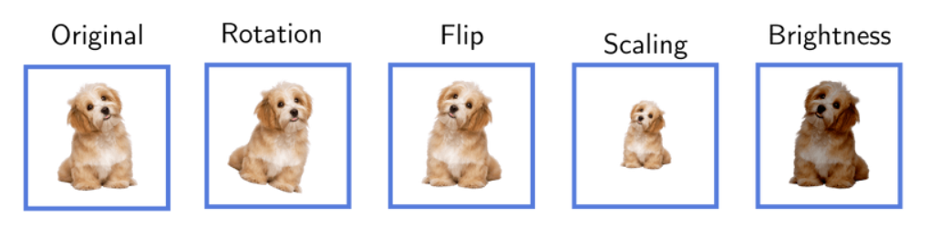
Data Augmentation

Slide 41
CNN Architectures

Slide 42
Le Net CNN Architecture
Handwritten digit recognition, developed by Yann Lecun in the 90s.
At a high level, LeNet (LeNet-5) consists of two parts: (i) a convolutional encoder consisting of two convolutional layers; and (ii) a dense block consisting of three fully connected layers;
The basic units in each convolutional block are a convolutional layer, a sigmoid activation function, and a subsequent average pooling operation.
Note that while ReLUs and max-pooling work better, these discoveries had not yet been made at the time.
Each convolutional layer uses a 5×5 kernel.

Slide 43
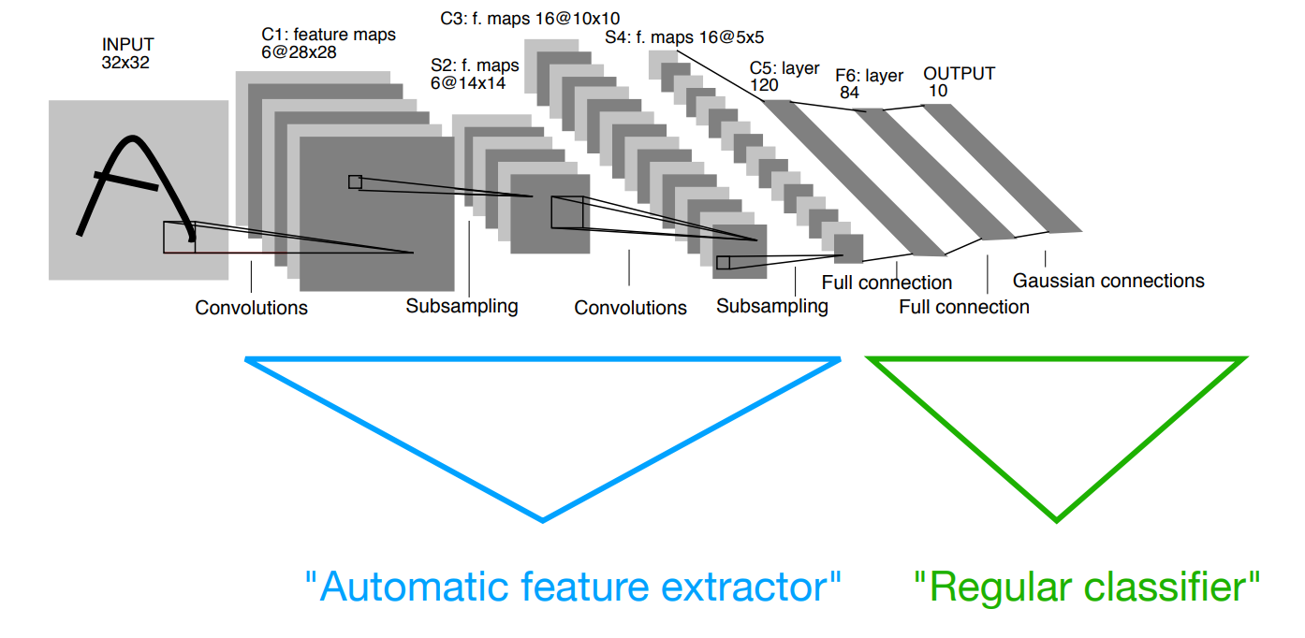
Hidden Layers

Slide 44
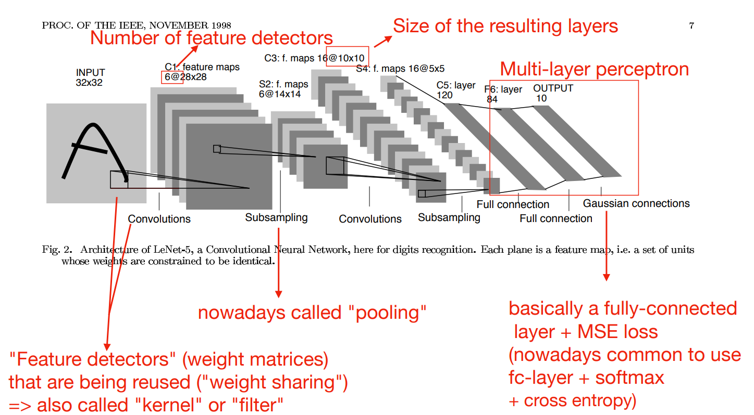
Le Net

Slide 45
AlexNet
Similar to LeNet but much bigger/deeper - around 60 million parameters
Invented by Alex Krizhevsky from Geoff Hinton's U of Toronto research group
Winner of the 2012 ImageNet.
Achieved 15.4% top-5 error rate. Next best 26.2% (Nowadays around 3%)

Slide 46
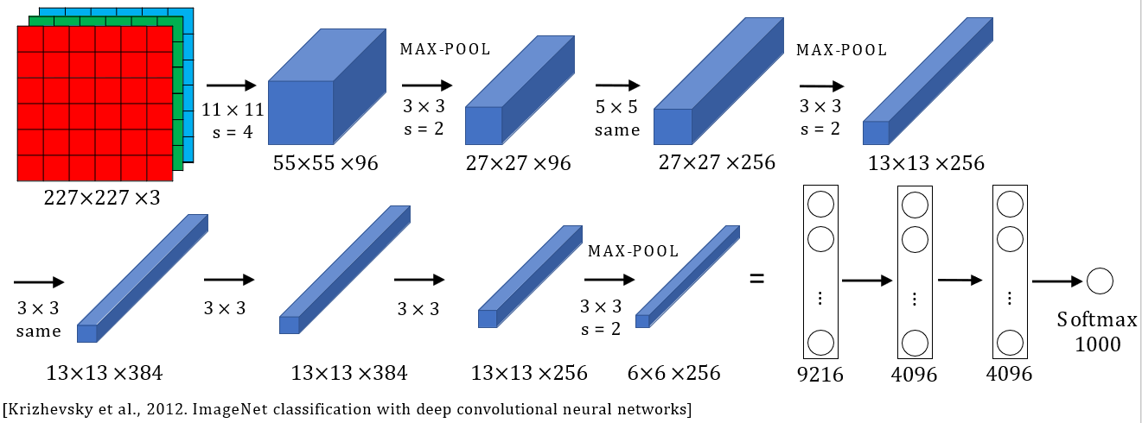
AlexNet

Slide 47
AlexNet Tricks
Multiple (small - 3GB) GPUs
Filters in the first conv layers much bigger than in the later layers
Uses ReLU instead of Sigmoid
Uses stride of 4 to reduce the dimensions in the first layers
Overlapping maxpool layers
One of the first to use Dropout
One of the first to use data augmentation

Slide 48
VGG
Developed by Visual Geometry Group at The University of Oxford in 2014
Similar to AlexNet but much bigger/deeper - 138m parameters
Along with GoogLeNet is the first to bring the top-5 error rate below 10%
There are several variants - VGG-11, VGG-13, VGG-16, VGG-19

Slide 49
VGG Tricks
Simplifies the architecture
Same filters (3x3, stride - 1, padding - same) for all layers
Same pooling (2x2, stride - 2)
Double the number of filters after every stack of conv layers
As you go deeper height and width go down and the number of channels goes up

Slide 50
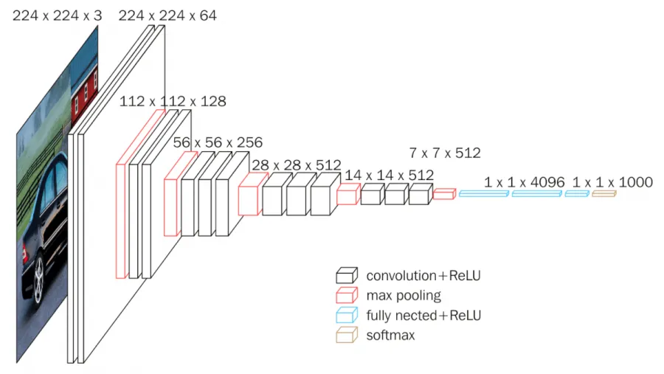
VGG 16

Slide 51
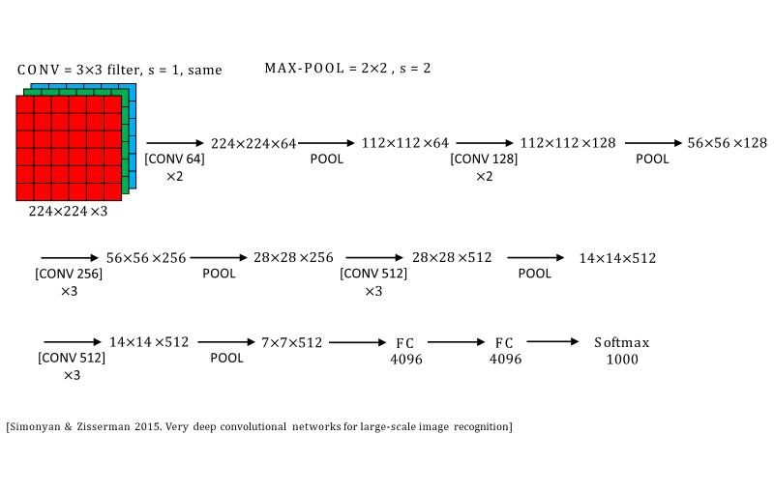
VGG 16

Slide 52
Residual Networks (ResNet)

Slide 53
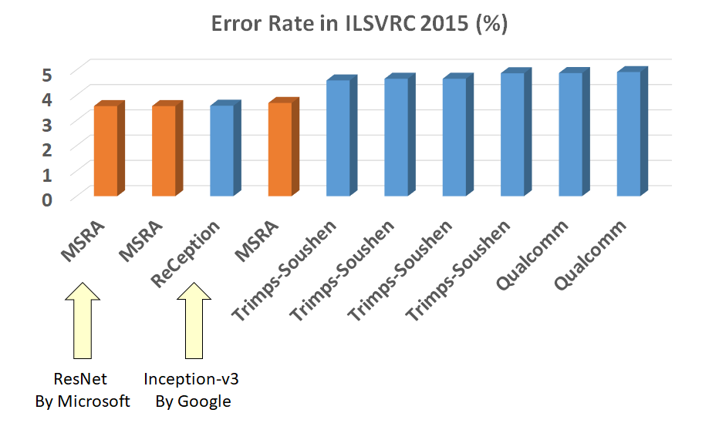
Residual Networks (ResNet)
Invented by Microsoft Research, winner of the ImageNet 2015 Very deep network consisting of residual blocks that improve the gradient flow and reduces the vanishing gradient

Slide 54
ResNet The Problem
The goal was to increase the depth of the CNNs
Deeper CNNs perform better, generalized better, achieve lower training loss BUT optimizing them is hard - vanishing gradient
This is not a problem of overfitting
The deeper you go into the network each layer would not learn much and thus it should be able to default to the identity function

Slide 55
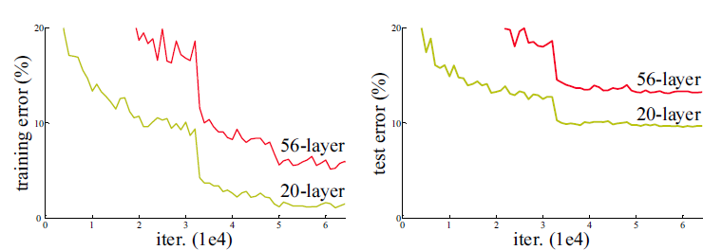
Plain network: Vanishing gradient
The deeper network has higher error rate not only during testing but even on training. This suggests that the training process is so hard it is unable to overfit although it has much bigger number of parameters.

Slide 56
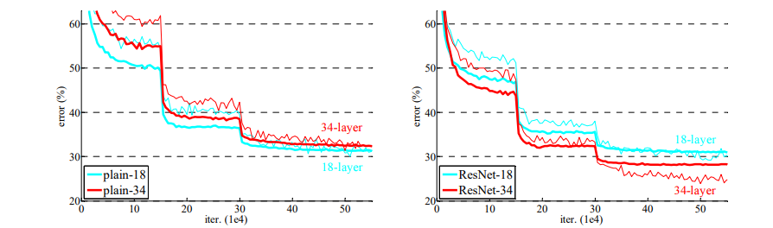
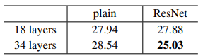
ResNets VS Plain network

Slide 57
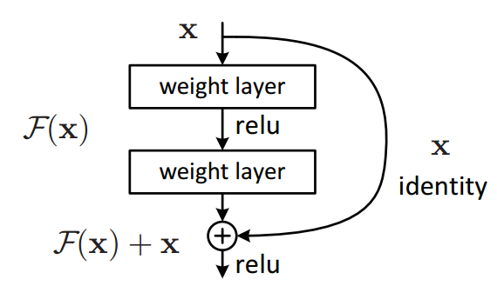
Residual Networks (ResNet)
Residual layer
The layer is called residual because it has to learn the residual mapping F(x)= H(x) - x

Slide 58
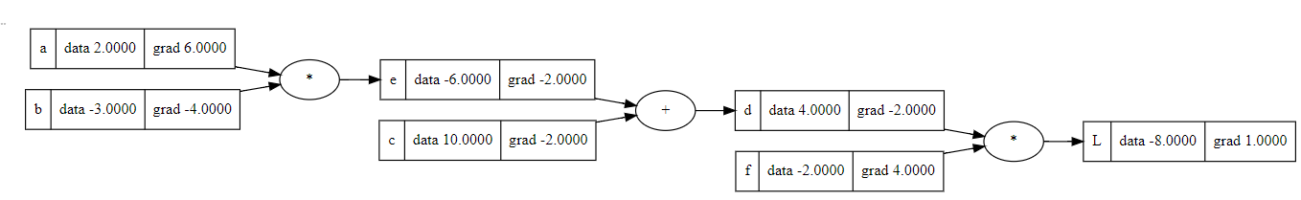
Residual Networks (ResNet Gradient) Gr
Derivative of summation is very easy to calculate - it distributes the derivative to all child nodes.
Y = F(X) + X
Local -> dY/dX = 1 using the chain rule -> dL/dX = 1 * dL/dY
Local -> dY/dF(X) = 1 using the chain rule -> dL/dF(X) = 1 * dL/dY

Slide 59
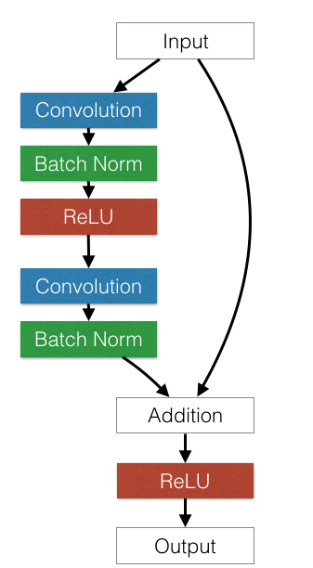
Residual Layer
This path is very useful for backpropagation
Provides immediate feedback,
skips 2 Conv and 2 BatchNorm layers
It is usually called skip or shortcut connection
The dimensions of the input and the output of the second BatchNorm have to match

Slide 60
Residual Layer
The Conv-BatchNorm-ReLU block is fundamental for many networks
This path is very useful for backpropagation
Provides immediate feedback,
skips 2 Conv and 2 BatchNorm layers
It is usually called skip or shortcut connection

Slide 61
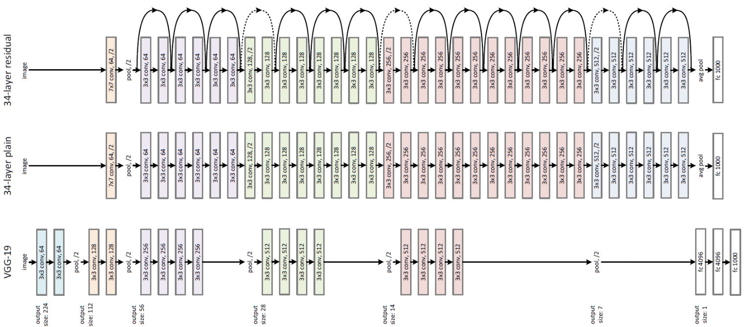
Residual Network: Example and Comparison
Residual block
Empirically shown easier to train a 34-layer deep residual net than a plain
network

Slide 62
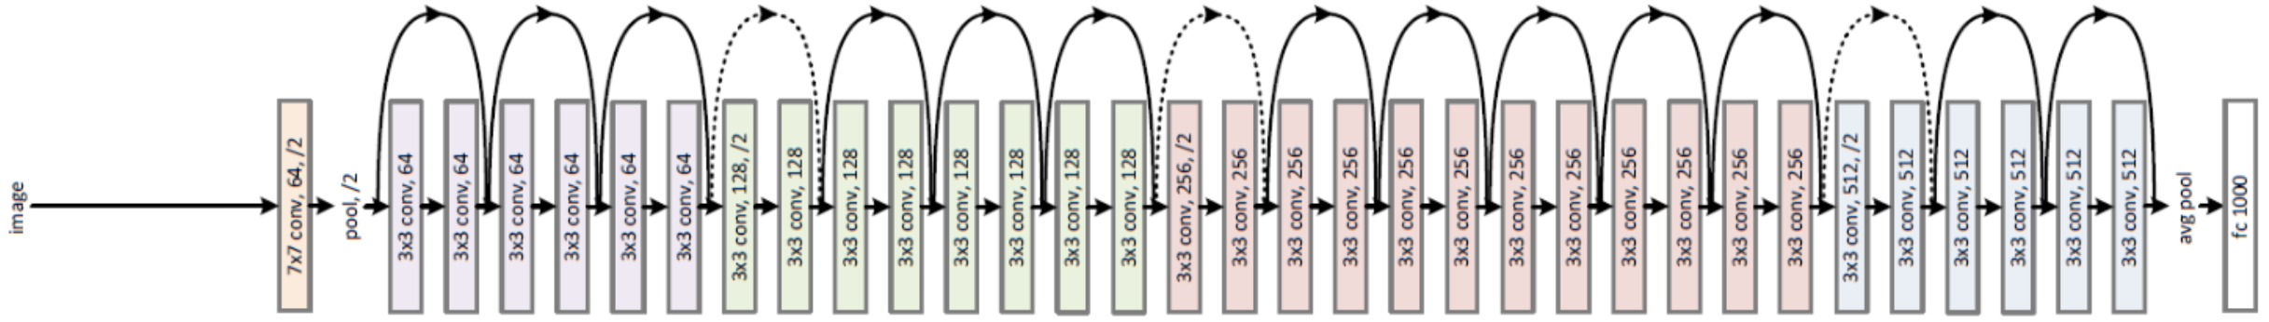
ResNet: Downsampling
ResNet downsamples the input spatial dimensions 32 times using pooling or conv with stride 2

Slide 63
ResNet: Downsampling
ResNet downsamples the input spatial dimensions 32 times using pooling or conv with stride 2 To add a skip connection after dimensionality change use 1-1 convolutions

Slide 64
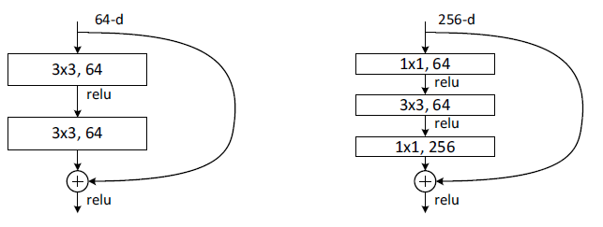
Residual Layer
Basic
Basic with bottleneck
ResNet uses a bottleneck to avoid parameter explosion With bottleneck, a 34-layer deep ResNet becomes a 50-layer ResNet
Notes:
- bottleneck
- 34 becomes 50

Slide 65
Transfer Learning

Slide 66
Transfer Learning
“You need a lot of data if you want to train CNN / Deep Neural Network”

Slide 67

Transfer Learning
“You need a lot of data if you want to train CNN / Deep Neural Network”

Slide 68
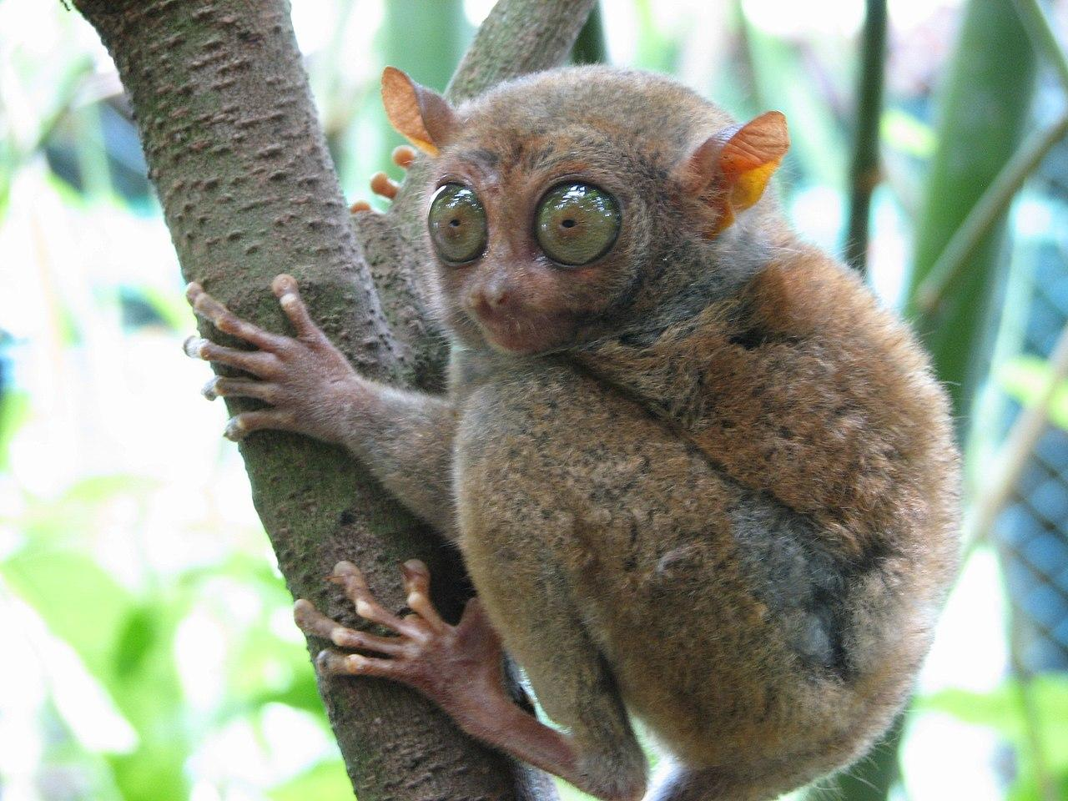
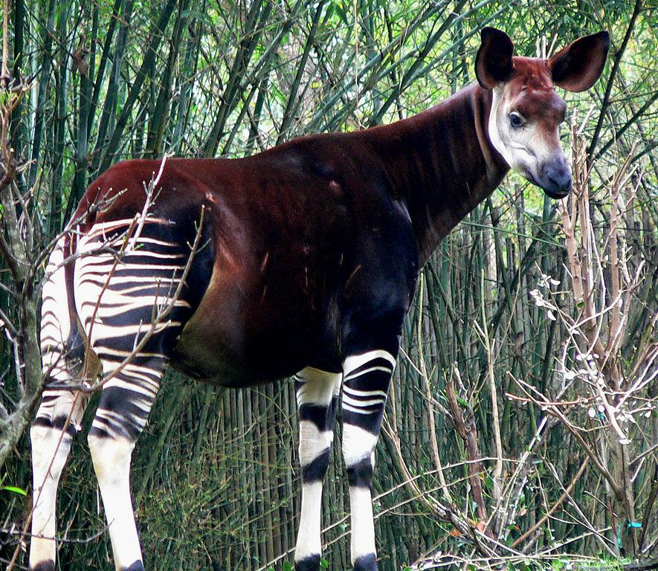
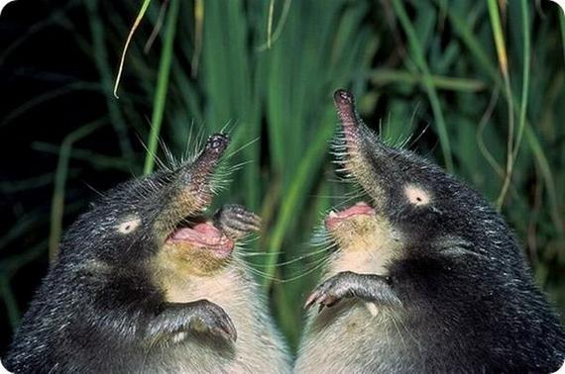
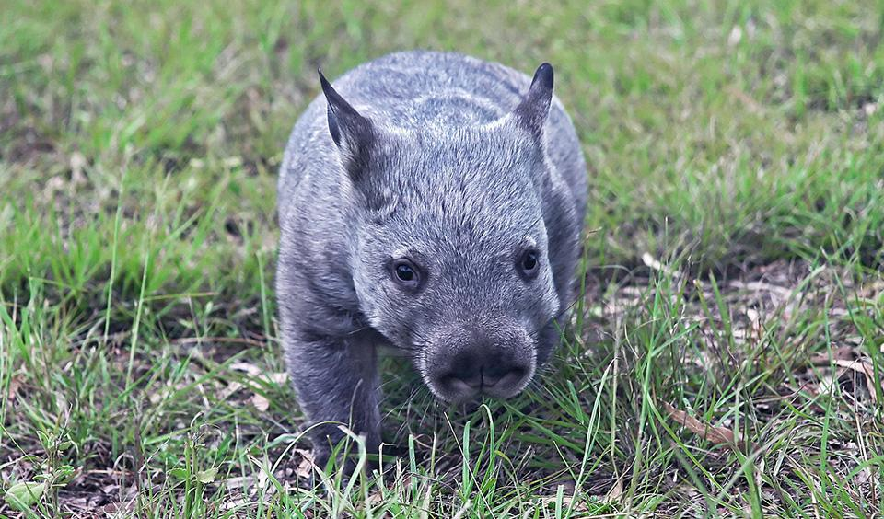
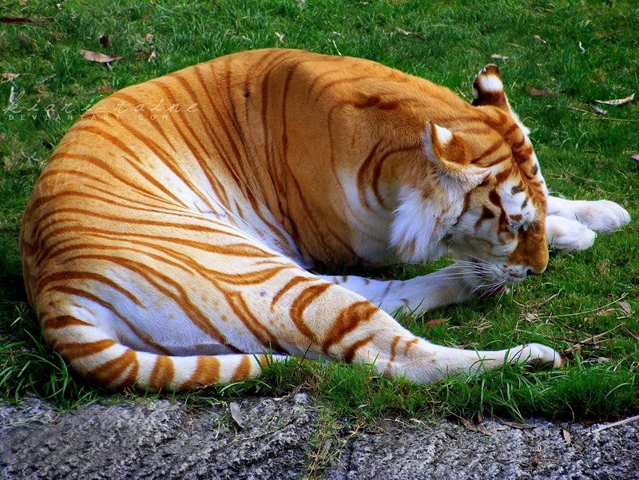
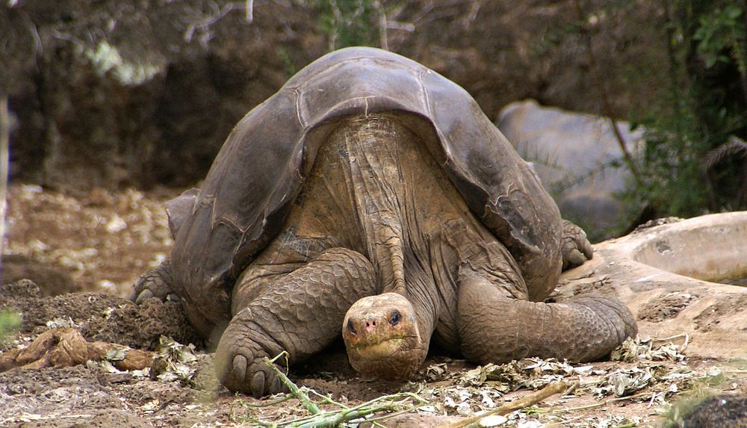
How to build a [Rare animals classifier]
6 new animal classes
50 examples per class
very hard to obtain new examples (hard to photograph)

Slide 69
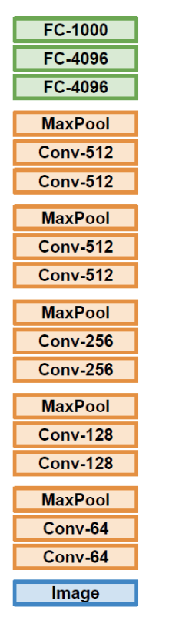
Transfer Learning
1. Train on ImageNet

Slide 70
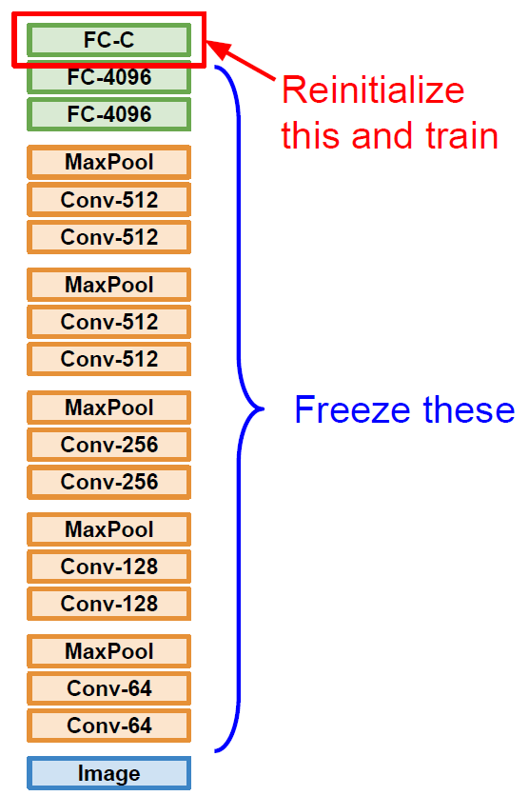
Transfer Learning
1. Train on ImageNet
2. Small dataset (C classes)

Slide 71
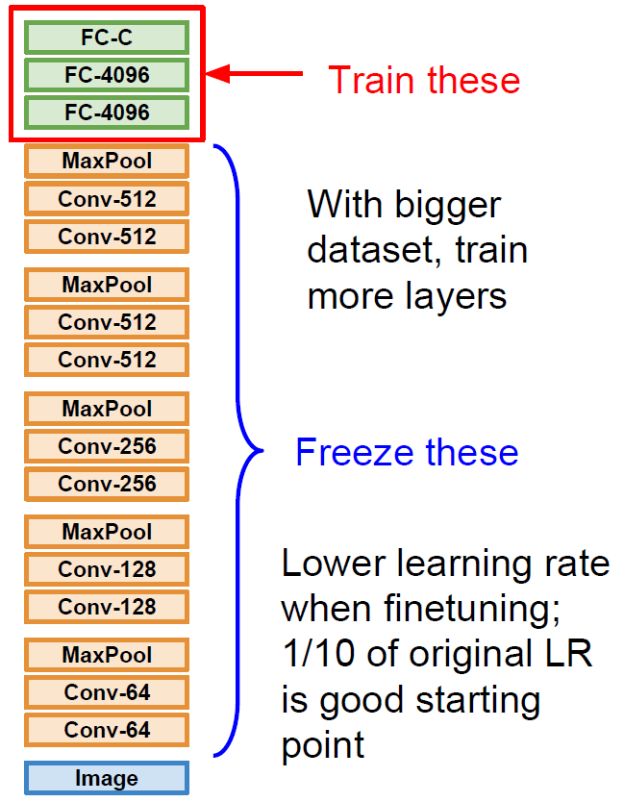
Transfer Learning
1. Train on ImageNet
2. Small dataset (C classes)
3. Bigger dataset

Slide 72
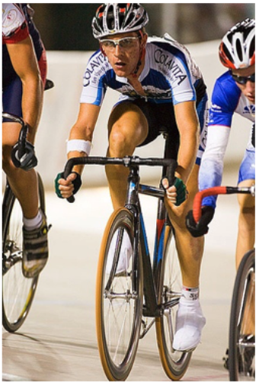
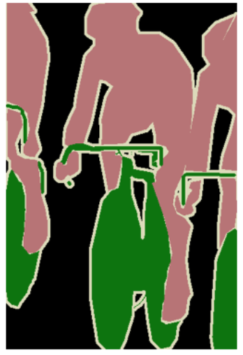
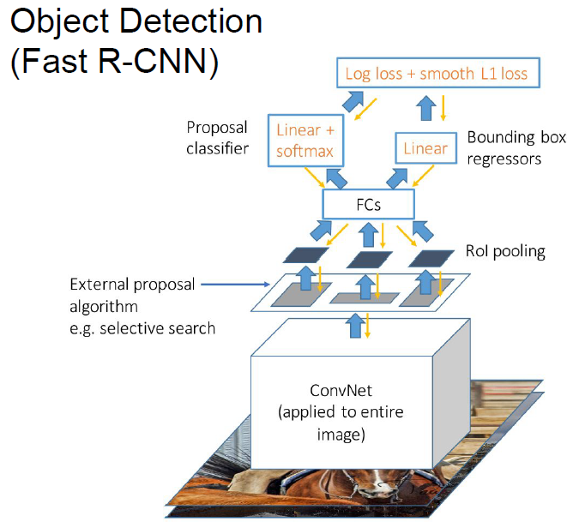
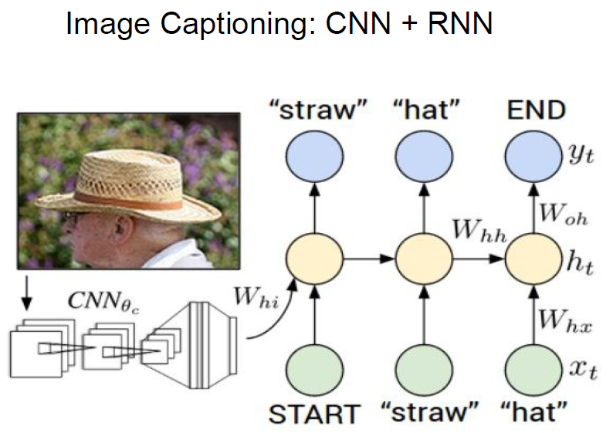
Transfer Learning on other tasks
Semantic Segmentation
very pervasive, the norm rather than exception
Encoder CNN (ResNet pretrained on ImageNet)
Decoder CNN
Pretrained

Slide 73
References
First Principles of Computer Vision (Shree Nayar)
Convolutional Neural Networks (Course 4 of the Deep Learning Specialization)
CS231n: Deep Learning for Computer Vision - Stanford University
Introduction to Deep Learning by Sebastian Raschka
Dive into Deep Learning - Zhang, Lipton, Li

